Slide 8
Single-Celled Organisms
http://safeshare.tv/w/cKrzGXcZkP
© LoveLearning 2014

Slide 12
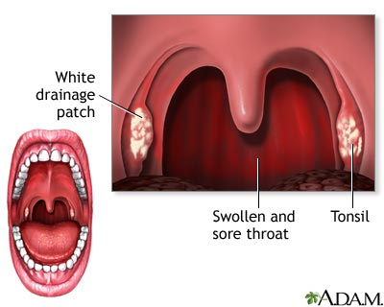
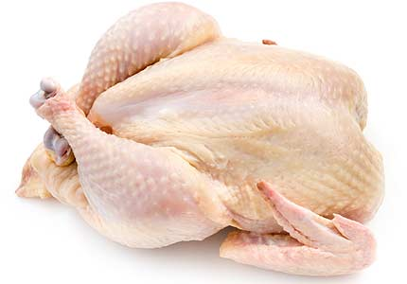
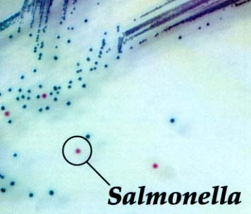
Harmful Microorganisms
Some harmful bacteria such as Salmonella and E. coli can make you sick
Found in raw chicken and meat, raw eggs, and other foods
If these foods touch other foods, the bacteria can spread
Cooking food kills this bacteria, but the bacteria will begin to grow again if the food is left out of the refrigerator for more than two hours
Strep throat is caused by harmful bacteria
http://www.brainpop.com/science/diversityoflife/bacteria/

Slide 20
Living with Microorganisms
Wash hands often and cook food carefully
Antibiotics cure diseases caused by bacteria
Cannot cure diseases caused by fungi or viruses
Can kill both good and bad bacteria
Eating yogurt puts back good bacteria in your body
http://peer.tamu.edu/curriculum_modules/Properties/module_1/Activity_bacteria.htm
© LoveLearning 2014

Slide 21
Protect! Don’t Infect!
http://safeshare.tv/w/bBRlgcprwH
© LoveLearning 2014

Slide 22
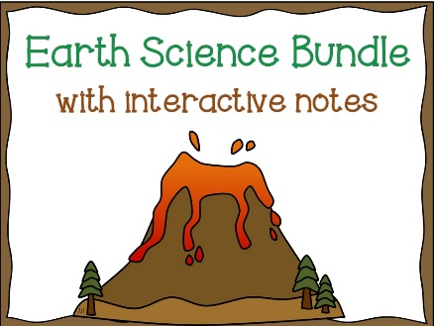
Terms of Use
Thank you for downloading this product! Redistributing, editing, selling, or posting this resource on the internet (including your classroom website) are strictly prohibited unless you have gained permission from the author. Violations are subject to penalties of the Digital Millennium Copyright Act. If you would like to share this product with colleagues, please purchase the multiple user license.
More Resources:
Follow me for classroom ideas, updates, and freebies!

Slide 23
Graphics From:
www.teacherspayteachers.com/store/Lindy-Du-Plessis
www.mycutegraphics.com

